Slide 1

Structural testing
Sometime called white-box testing
Derivation of test cases according to program structure. Knowledge of the program is used to identify additional test cases
Objective is to exercise all program statements (not all path combinations)

Slide 2
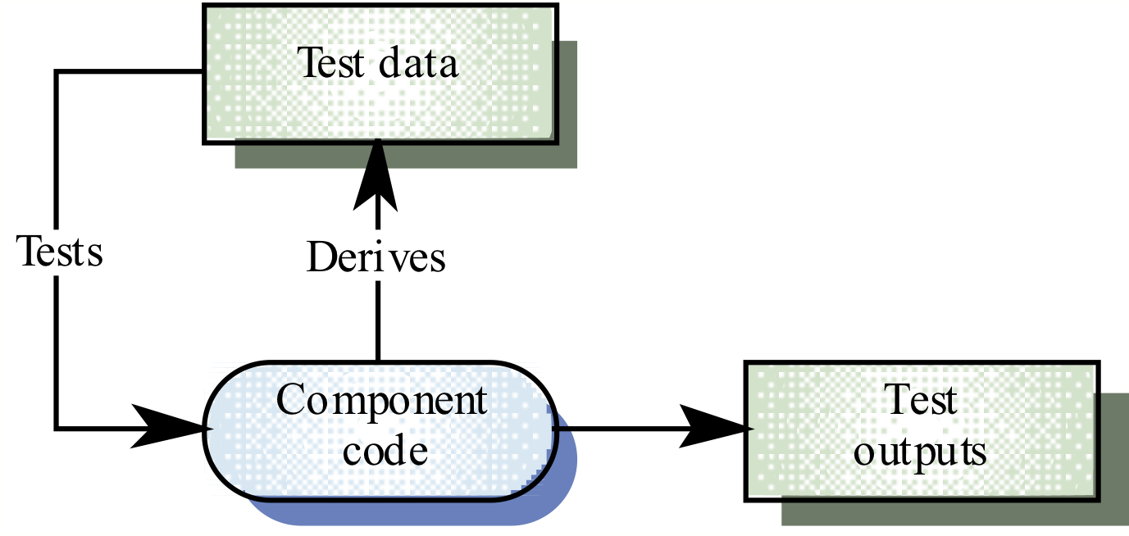
White-box testing

Slide 3
Path testing
The objective of path testing is to ensure that the set of test cases is such that each path through the program is executed at least once
The starting point for path testing is a program flow graph that shows nodes representing program decisions and arcs representing the flow of control
Statements with conditions are therefore nodes in the flow graph

Slide 4
Program flow graphs
Describes the program control flow. Each branch is shown as a separate path and loops are shown by arrows looping back to the loop condition node
Used as a basis for computing the cyclomatic complexity
Cyclomatic complexity = Number of edges - Number of nodes +2

Slide 5
Cyclomatic complexity
The number of tests to test all control statements equals the cyclomatic complexity
Cyclomatic complexity equals number of conditions in a program
Useful if used with care. Does not imply adequacy of testing.
Although all paths are executed, all combinations of paths are not executed

Slide 6
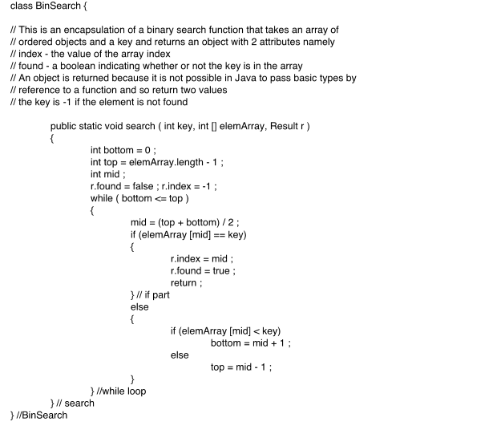
Binary search (Java)

Slide 7
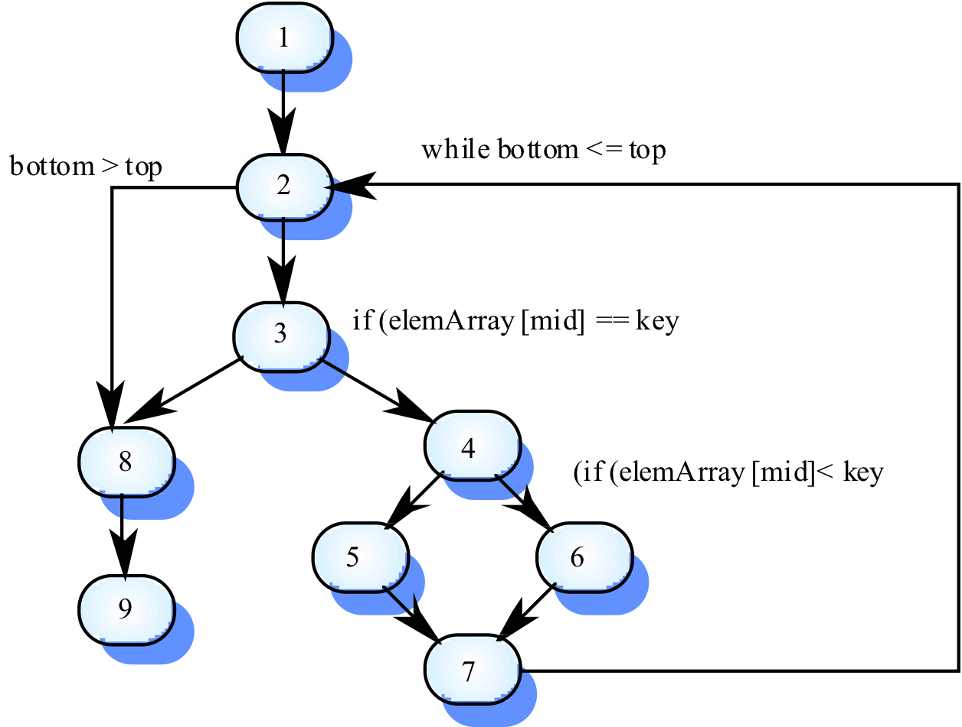
Binary search flow graph

Slide 8
Independent paths
1, 2, 3, 8, 9
1, 2, 3, 4, 6, 7, 2
1, 2, 3, 4, 5, 7, 2
1, 2, 3, 4, 6, 7, 2, 8, 9
Test cases should be derived so that all of these paths are executed
A dynamic program analyser may be used to check that paths have been executed

Slide 9
Component testing
Software components are often composite components that are made up of several interacting objects.
For example, in the weather station system, the reconfiguration component includes objects that deal with each aspect of the reconfiguration.
You access the functionality of these objects through the defined component interface.
Testing composite components should therefore focus on showing that the component interface behaves according to its specification.
You can assume that unit tests on the individual objects within the component have been completed.
Chapter 8 Software testing

Slide 10
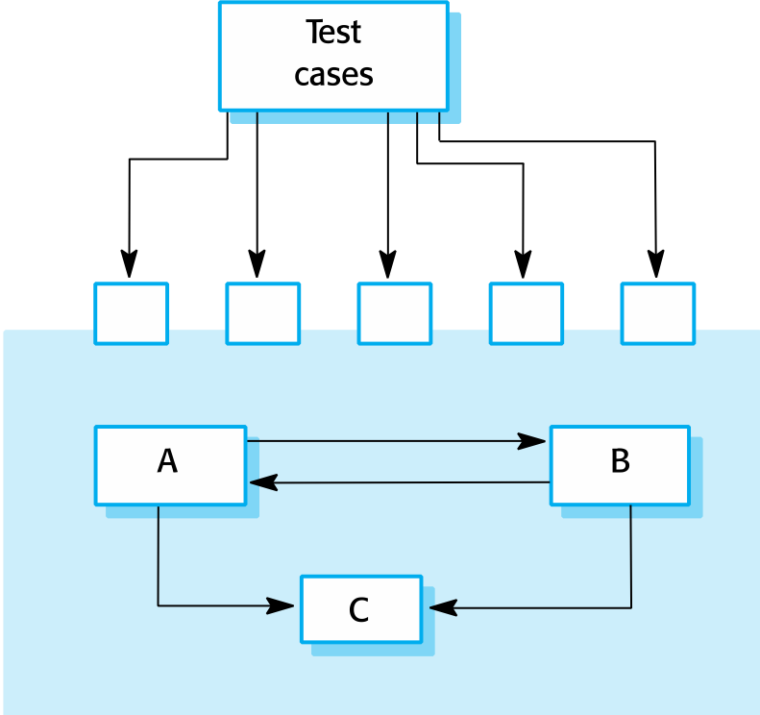
Interface testing
Chapter 8 Software testing

Slide 11
Interface testing
Objectives are to detect faults due to interface errors or invalid assumptions about interfaces.
Interface types
Parameter interfaces Data passed from one method or procedure to another.
Shared memory interfaces Block of memory is shared between procedures or functions.
Procedural interfaces Sub-system encapsulates a set of procedures to be called by other sub-systems.
Message passing interfaces Sub-systems request services from other sub-systems
Chapter 8 Software testing

Slide 12
Interface errors
Interface misuse
A calling component calls another component and makes an error in its use of its interface e.g. parameters in the wrong order.
Interface misunderstanding
A calling component embeds assumptions about the behaviour of the called component which are incorrect.
Timing errors
The called and the calling component operate at different speeds and out-of-date information is accessed.
Chapter 8 Software testing

Slide 13
Interface testing guidelines
Design tests so that parameters to a called procedure are at the extreme ends of their ranges.
Always test pointer parameters with null pointers.
Design tests which cause the component to fail.
Use stress testing in message passing systems.
In shared memory systems, vary the order in which components are activated.
Chapter 8 Software testing

Slide 14
System testing
System testing during development involves integrating components to create a version of the system and then testing the integrated system.
The focus in system testing is testing the interactions between components.
System testing checks that components are compatible, interact correctly and transfer the right data at the right time across their interfaces.
System testing tests the emergent behaviour of a system.
Chapter 8 Software testing

Slide 15
Use-case testing
The use-cases developed to identify system interactions can be used as a basis for system testing.
Each use case usually involves several system components so testing the use case forces these interactions to occur.
The sequence diagrams associated with the use case documents the components and interactions that are being tested.
Chapter 8 Software testing

Slide 16
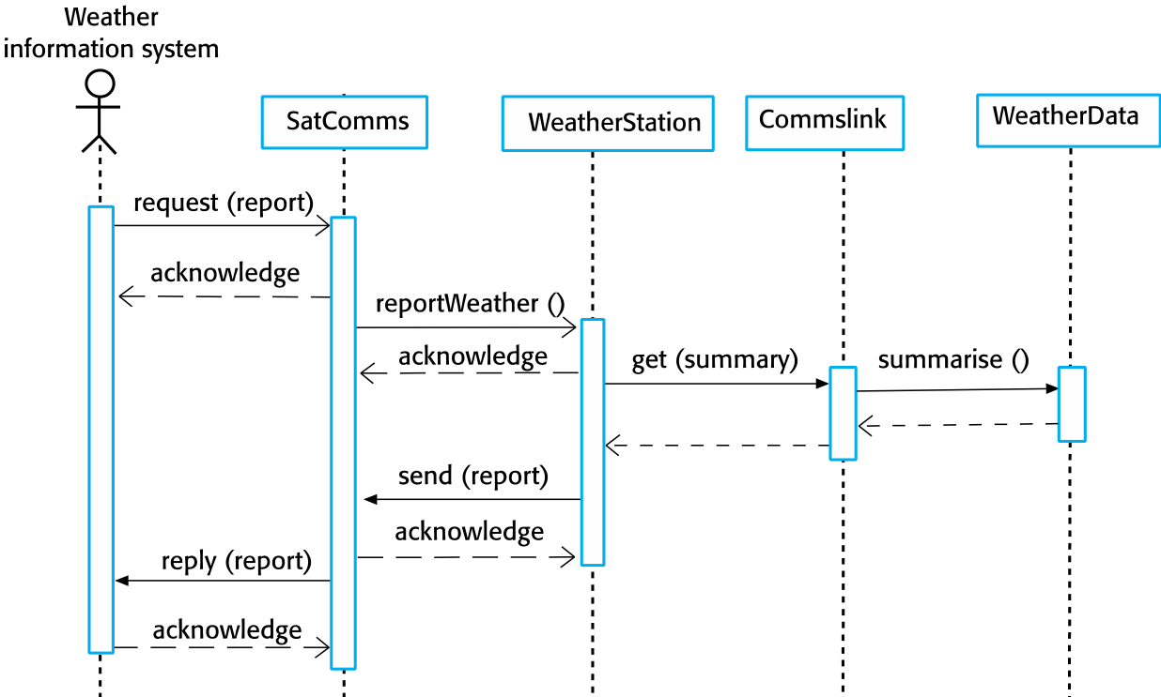
Collect weather data sequence chart
Chapter 8 Software testing

Slide 17
Testing policies
Exhaustive system testing is impossible so testing policies which define the required system test coverage may be developed.
Examples of testing policies:
All system functions that are accessed through menus should be tested.
Combinations of functions (e.g. text formatting) that are accessed through the same menu must be tested.
Where user input is provided, all functions must be tested with both correct and incorrect input.
Chapter 8 Software testing

Slide 18
Test-driven development
Test-driven development (TDD) is an approach to program development in which you inter-leave testing and code development.
Tests are written before code and ‘passing’ the tests is the critical driver of development.
You develop code incrementally, along with a test for that increment. You don’t move on to the next increment until the code that you have developed passes its test.
TDD was introduced as part of agile methods such as Extreme Programming. However, it can also be used in plan-driven development processes.
Chapter 8 Software testing

Slide 19
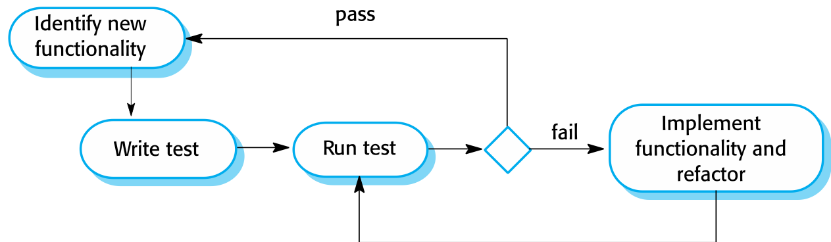
Test-driven development
Chapter 8 Software testing

Slide 20
TDD process activities
Start by identifying the increment of functionality that is required. This should normally be small and implementable in a few lines of code.
Write a test for this functionality and implement this as an automated test.
Run the test, along with all other tests that have been implemented. Initially, you have not implemented the functionality so the new test will fail.
Implement the functionality and re-run the test.
Once all tests run successfully, you move on to implementing the next chunk of functionality.
Chapter 8 Software testing

Slide 21
Benefits of test-driven development
Code coverage
Every code segment that you write has at least one associated test so all code written has at least one test.
Regression testing
A regression test suite is developed incrementally as a program is developed.
Simplified debugging
When a test fails, it should be obvious where the problem lies. The newly written code needs to be checked and modified.
System documentation
The tests themselves are a form of documentation that describe what the code should be doing.
Chapter 8 Software testing

Slide 22
Regression testing
Regression testing is testing the system to check that changes have not ‘broken’ previously working code.
In a manual testing process, regression testing is expensive but, with automated testing, it is simple and straightforward. All tests are rerun every time a change is made to the program.
Tests must run ‘successfully’ before the change is committed.
Chapter 8 Software testing

Slide 23
Release testing
Release testing is the process of testing a particular release of a system that is intended for use outside of the development team.
The primary goal of the release testing process is to convince the supplier of the system that it is good enough for use.
Release testing, therefore, has to show that the system delivers its specified functionality, performance and dependability, and that it does not fail during normal use.
Release testing is usually a black-box testing process where tests are only derived from the system specification.
Chapter 8 Software testing

Slide 24
Release testing and system testing
Release testing is a form of system testing.
Important differences:
A separate team that has not been involved in the system development, should be responsible for release testing.
System testing by the development team should focus on discovering bugs in the system (defect testing). The objective of release testing is to check that the system meets its requirements and is good enough for external use (validation testing).
Chapter 8 Software testing

Slide 25
Requirements based testing
Requirements-based testing involves examining each requirement and developing a test or tests for it.
MHC-PMS requirements:
If a patient is known to be allergic to any particular medication, then prescription of that medication shall result in a warning message being issued to the system user.
If a prescriber chooses to ignore an allergy warning, they shall provide a reason why this has been ignored.
Chapter 8 Software testing

Slide 26
Requirements tests
Set up a patient record with no known allergies. Prescribe medication for allergies that are known to exist. Check that a warning message is not issued by the system.
Set up a patient record with a known allergy. Prescribe the medication to that the patient is allergic to, and check that the warning is issued by the system.
Set up a patient record in which allergies to two or more drugs are recorded. Prescribe both of these drugs separately and check that the correct warning for each drug is issued.
Prescribe two drugs that the patient is allergic to. Check that two warnings are correctly issued.
Prescribe a drug that issues a warning and overrule that warning. Check that the system requires the user to provide information explaining why the warning was overruled.
Chapter 8 Software testing

Slide 27
Scenario testing
An approach to release testing whereby you devise typical scenarios of use and use these scenarios to develop test cases.
A scenario is a story that describes one way in which the system might be used.
Some features related the scenario will be tested.
Chapter 8 Software testing

Slide 28
A usage scenario for the MHC-PMS
Kate is a nurse who specializes in mental health care. One of her responsibilities is to visit patients at home to check that their treatment is effective and that they are not suffering from medication side -effects.
On a day for home visits, Kate logs into the MHC-PMS and uses it to print her schedule of home visits for that day, along with summary information about the patients to be visited. She requests that the records for these patients be downloaded to her laptop. She is prompted for her key phrase to encrypt the records on the laptop.
One of the patients that she visits is Jim, who is being treated with medication for depression. Jim feels that the medication is helping him but believes that it has the side -effect of keeping him awake at night. Kate looks up Jim’s record and is prompted for her key phrase to decrypt the record. She checks the drug prescribed and queries its side effects. Sleeplessness is a known side effect so she notes the problem in Jim’s record and suggests that he visits the clinic to have his medication changed. He agrees so Kate enters a prompt to call him when she gets back to the clinic to make an appointment with a physician. She ends the consultation and the system re-encrypts Jim’s record.
After, finishing her consultations, Kate returns to the clinic and uploads the records of patients visited to the database. The system generates a call list for Kate of those patients who she has to contact for follow-up information and make clinic appointments.
Chapter 8 Software testing

Slide 29
Features tested by scenario
Authentication by logging on to the system.
Downloading and uploading of specified patient records to a laptop.
Home visit scheduling.
Encryption and decryption of patient records on a mobile device.
Record retrieval and modification.
Links with the drugs database that maintains side-effect information.
The system for call prompting.
Chapter 8 Software testing

Slide 30
Performance testing
Part of release testing may involve testing the emergent properties of a system, such as performance and reliability.
Tests should reflect the profile of use of the system.
Performance tests usually involve planning a series of tests where the load is steadily increased until the system performance becomes unacceptable.
Stress testing is a form of performance testing where the system is deliberately overloaded to test its failure behaviour.
Chapter 8 Software testing

Slide 31
User testing
User or customer testing is a stage in the testing process in which users or customers provide input and advice on system testing.
User testing is essential, even when comprehensive system and release testing have been carried out.
The reason for this is that influences from the user’s working environment have a major effect on the reliability, performance, usability and robustness of a system. These cannot be replicated in a testing environment.
Chapter 8 Software testing

Slide 32
Types of user testing
Alpha testing
Users of the software work with the development team to test the software at the developer’s site.
Beta testing
A release of the software is made available to users to allow them to experiment and to raise problems that they discover with the system developers.
Acceptance testing
Customers test a system to decide whether or not it is ready to be accepted from the system developers and deployed in the customer environment. Primarily for custom systems.
Chapter 8 Software testing

Slide 33
The acceptance testing process
Chapter 8 Software testing

Slide 34
Agile methods and acceptance testing
In agile methods, the user/customer is part of the development team and is responsible for making decisions on the acceptability of the system.
Tests are defined by the user/customer and are integrated with other tests in that they are run automatically when changes are made.
There is no separate acceptance testing process.
Main problem here is whether or not the embedded user is ‘typical’ and can represent the interests of all system stakeholders.
Chapter 8 Software testing

Slide 35
Key points
Testing can only show the presence of errors in a program. It cannot demonstrate that there are no remaining faults.
Development testing is the responsibility of the software development team. A separate team should be responsible for testing a system before it is released to customers.
Development testing includes unit testing, in which you test individual objects and methods component testing in which you test related groups of objects and system testing, in which you test partial or complete systems.
Chapter 8 Software testing

Slide 36
Key points
When testing software, you should try to ‘break’ the software by using experience and guidelines to choose types of test case that have been effective in discovering defects in other systems.
Wherever possible, you should write automated tests. The tests are embedded in a program that can be run every time a change is made to a system.
Test-first development is an approach to development where tests are written before the code to be tested.
Scenario testing involves inventing a typical usage scenario and using this to derive test cases.
Acceptance testing is a user testing process where the aim is to decide if the software is good enough to be deployed and used in its operational environment.
Chapter 8 Software testing

